Slide 1
Atomic, Kubernetes & Docker
by Vincent Batts
Centos DOJO Brussels
Jan 30, 2015

Slide 2
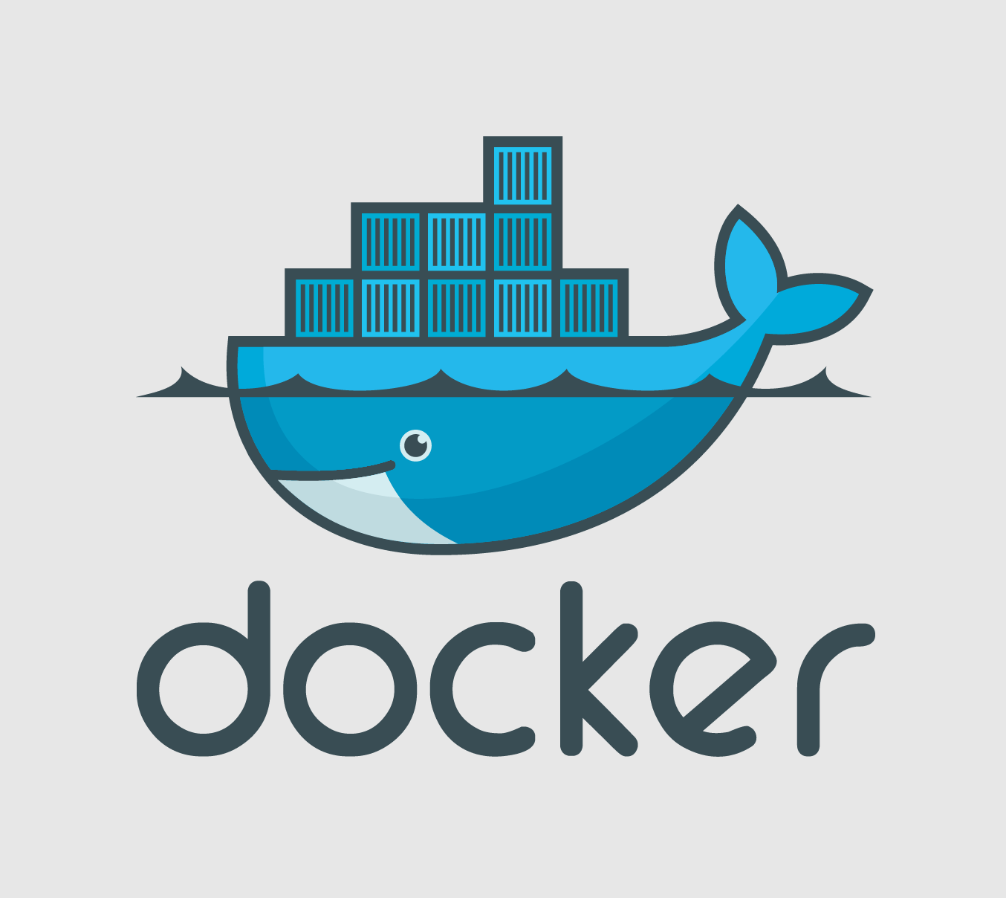







$> id vbatts

Slide 3
Overview
Docker
Kubernetes
Atomic

Slide 4
Information
This Preso
  https://vbatts.fedorapeople.org/talks/
Centos Atomic SIG
  http://wiki.centos.org/SpecialInterestGroup/Atomic
Get the images
  http://projectatomic.io For news
  http://buildlogs.centos.org/rolling/7/isos/x86_64/ For images

Slide 5
Overview
Docker
Kubernetes
Atomic

Slide 6
Docker
Container
Packaging
Ecosystem

Slide 7
Overview
Docker
Kubernetes
Atomic

Slide 8
Kubernetes
See eparis' slides
  http://people.redhat.com/~eparis/kubernetes/
Kube Source
  https://github.com/GoogleCloudPlatform/kubernetes.git
  See ./kubernetes/examples/

Slide 9
Overview
Docker
Kubernetes
Atomic

Slide 10
Atomic
Atomic Slides by Colin Walters
  http://www.bblisa.org/slides/201410-walters.pdf
Contact
  Freenode IRC - #atomic
  http://www.projectatomic.io/community/ For lists, etc.

Slide 11
Atomic
Read-only system files
Minimal

Slide 12
Atomic
ostree
  Like git for immutable, bootable filesystems
  https://wiki.gnome.org/OSTree
atomic (rpm-ostree)
  `atomic upgrade`
  `atomic rollback`

Slide 13
Information
Centos Atomic SIG
  http://wiki.centos.org/SpecialInterestGroup/Atomic
Get the images
  http://projectatomic.io For news
  http://buildlogs.centos.org/rolling/7/isos/x86_64/ For images

Slide 14
Questions?

